Slide 1
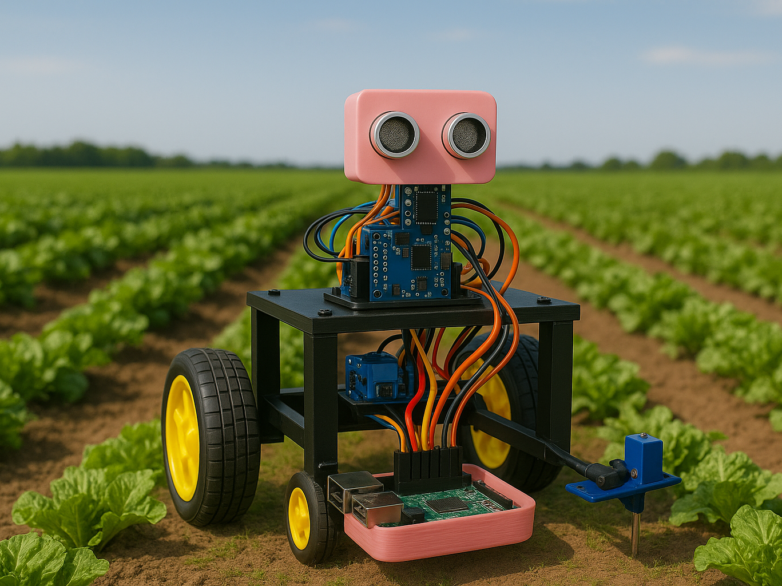
AgriBot AI-Powered Crop surveillance and Disease identification system
Presented at SRM Hackathon
By: Team Lakshya

Slide 2
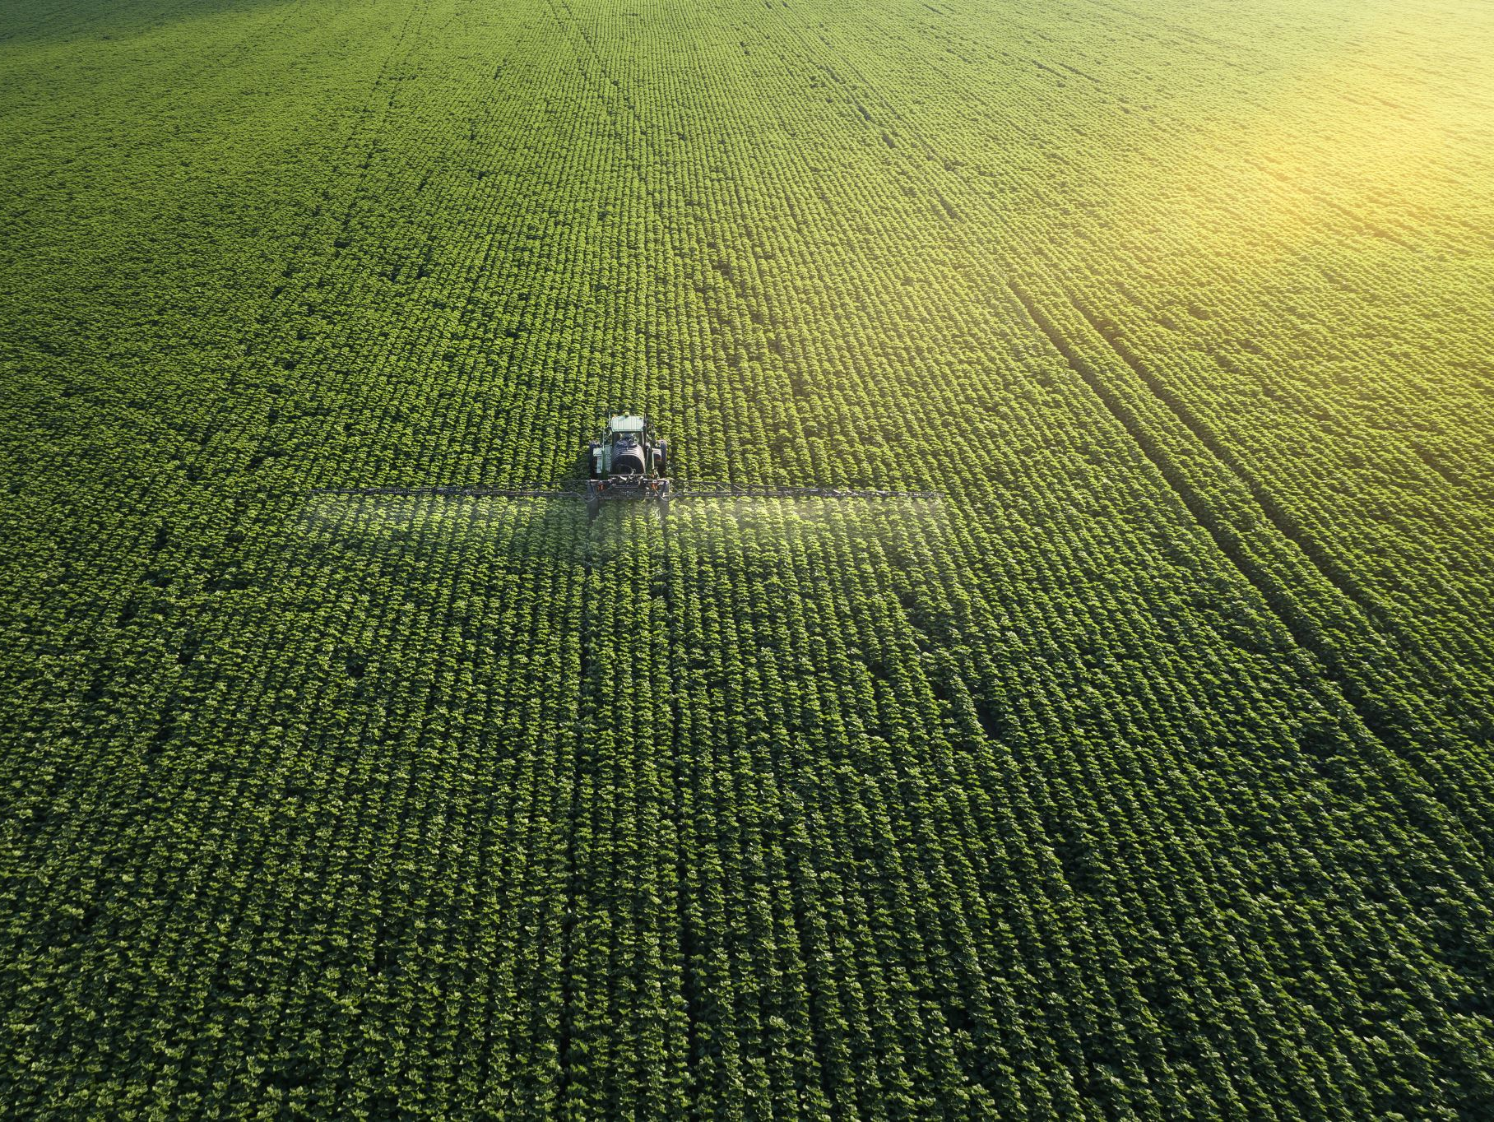
Problem Statement
Agriculture is the backbone of many economies but faces challenges like:
- Delayed disease detection
- Inefficient resource usage
- Lack of real-time crop monitoring
Traditional methods are labor-intensive and lack real-time insights.
There is a strong need for an intelligent, AI-driven, autonomous system.

Slide 3
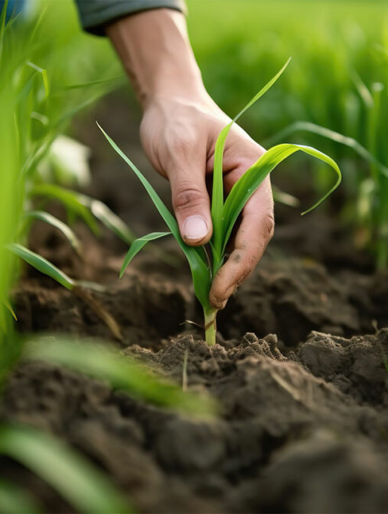
Why Agriculture Matters
Supports over 60% of livelihoods in India.
Key to food security and economic stability.
Innovations can uplift rural communities.
Precision tech like AgriBot ensures sustainable farming.
Reduces input cost, increases yield, and empowers farmers.

Slide 4


Objective:
To design and deploy an AI-powered Autonomous Bot capable of:
Real-time crop surveillance.
Disease detection using AI
Environmental conditions monitoring via sensors.
Dashboard/ telegram-bot based farmer interface.

Slide 5
Hardware Stack:
Four-wheel Chassis Kit
Servo Motors
Motor Driver(L298N)
3.7V Li-ion Batteries
Arduino UNO
Ultrasonic Sensor
Soil Sensor
DHT22 (For Temperature and Humidity)
Raspberry Pi-5
Pi Camera V2
Esp32 wroom module

Slide 6
Software Stack:
Microcontroller layer :
Platform: Arduino IDE
Language: C/C++ (Arduino Sketch)
Raspberry Pi layer :
Operating System: Raspberry Pi OS
Programming Language: Python
AI/ML component :
Model Used: ResNet 50

Slide 7

Methodology
1. Data Collection: Navigates farm, captures images and sensor data.
2. AI Disease Detection: Deep learning model identifies disease.
3. Dashboard: Displays data for farmers in a friendly interface.

Slide 8
Working of AgriBot
Moves through the crop fields(Present only for Brinjal and Tomato).
Captures images and environmental data.
Uses AI for real-time disease identification.
Displays results on an interface.
Enables timely action to prevent crop loss.

Slide 9
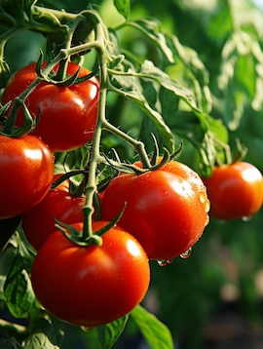
Expected Outcomes
Early and accurate crop disease identification.
Real-time health monitoring
Reduced yield loss.
Automated surveillance (no manual effort).
Easy-to-use interface for farmers.
Scalable to other crops and large farms.

Slide 10
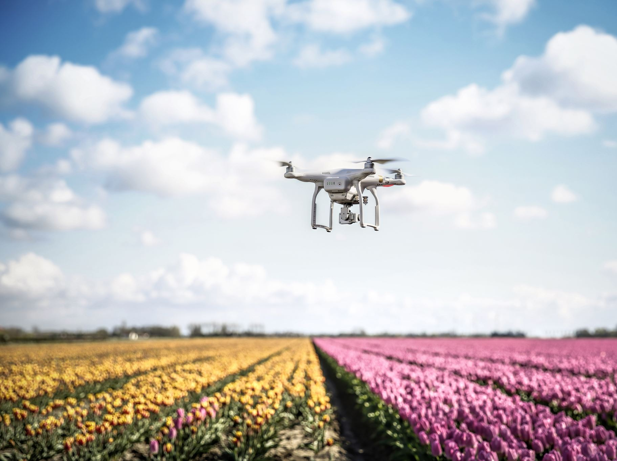
Future Scope
Add drones for aerial surveillance.
Train AI for more crops and pests.
Smart spraying of pesticides/fertilizers.
Edge AI processing on-board.
Use 5G & IoT for real-time remote access.
Regional language support for farmers.
Can implement LoRa module for long range low level communication

Slide 11
THANK YOU

